Slide 1
ESVC21-00011155
National Institute of Technology Jamshedpur
Team Revanta
COST REPORT
Electric Solar Vehicle Championship
STATIC ROUND

Slide 2
Cost Reduction Strategies
1. Filtration
2 . Comparison
3 . Quality check
•We have taken many steps for cost reduction and comparison in which some of them are as follows-
We filtered all the available dealers and providers by:
Online Resources
Word Of Mouth
We also visited the industrial belt region and surveyed the industries for the best dealers in the domain
We included our previous dealers in the list as well
After finalising the dealers post the filtration round:
We compared their total market cost (inclusive of transportation/delivery cost , taxes etc)
We also checked the possibilities of discounts, sponsorships and other likelihoods of mutual benefits.
Before physically visiting the shops:
We checked their customer reviews
We also analysed their brand value, after-sale services, sustainability in the market, permanent customer-base and many such parameters before visiting the best dealers.
After passing through all these stages the top dealers that stood out, were visited in-person by us. After making several in-person visits and meetings we finalised those deals that offered us the best quality in optimum rate.

Slide 3
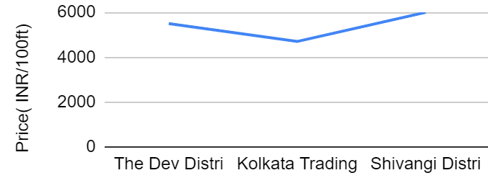
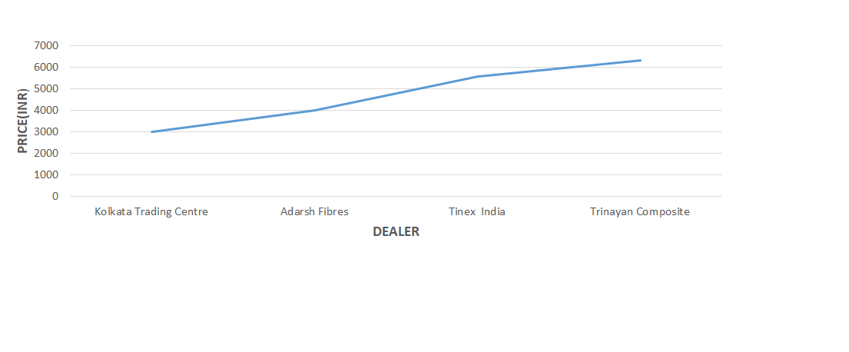
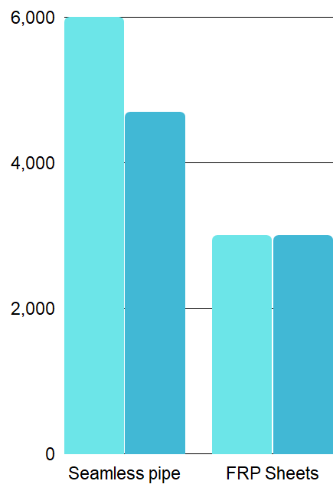
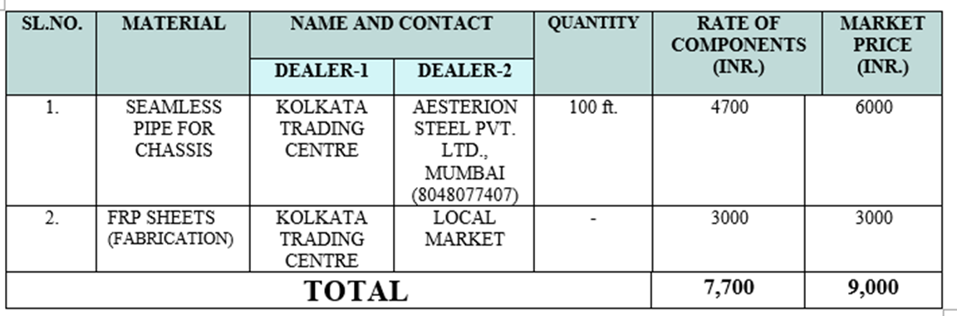


CHASSIS AND BODY MATERIAL
SEAMLESS PIPE FOR CHASSIS FRP SHEETS

Slide 4
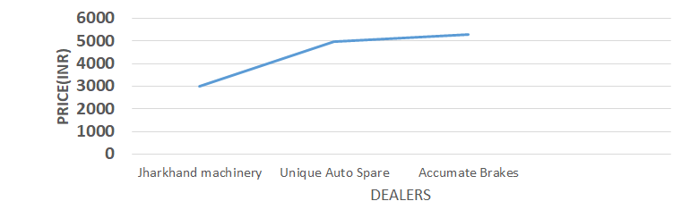
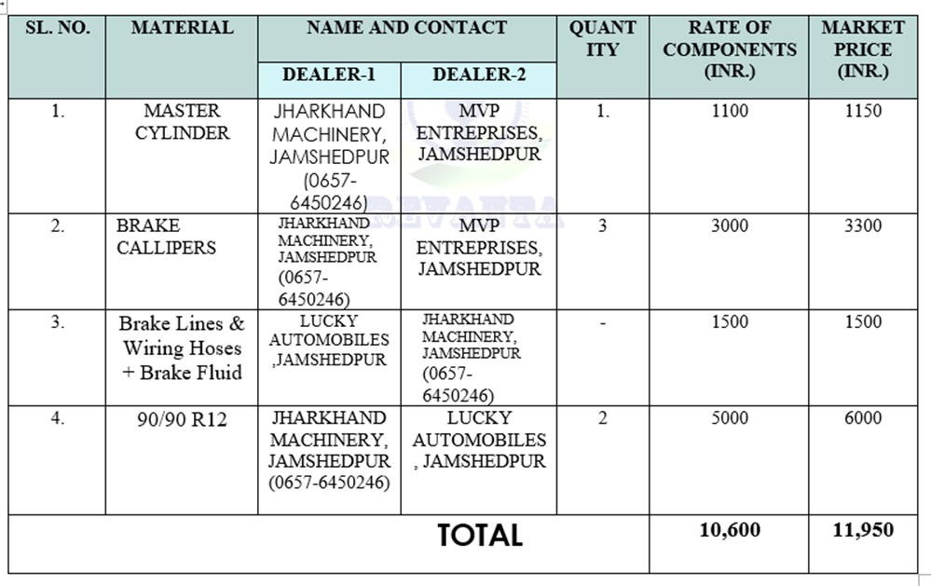
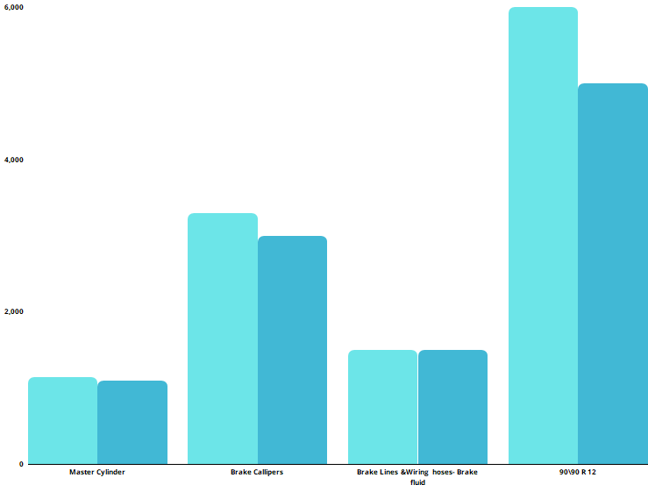

2. BRAKING, WHEELS AND TYRES
Brake Calipers
COST REDUCED = Rs 1350

Slide 5
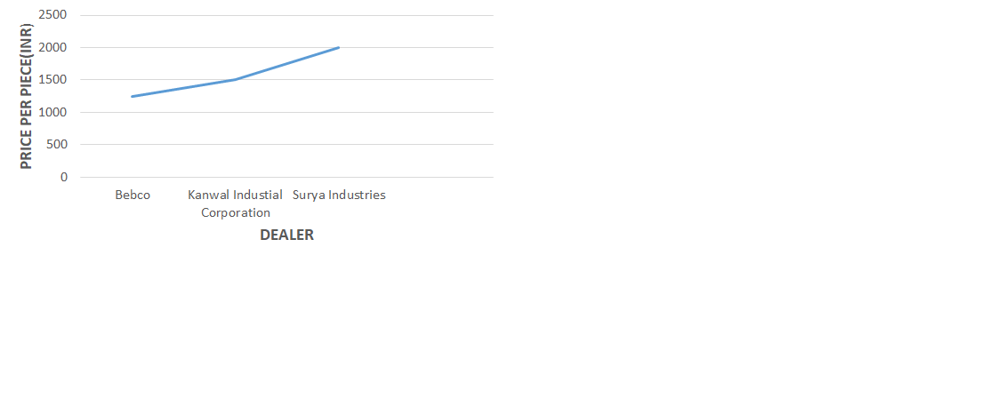
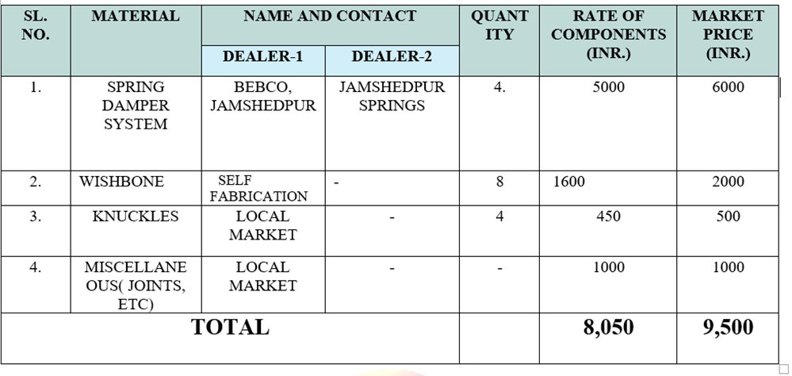
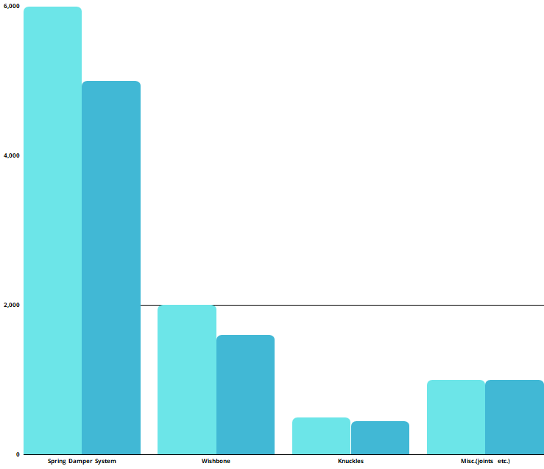
3. SUSPENSION SYSTEM
Spring Damper System
COST REDUCED = Rs 13384

Slide 6
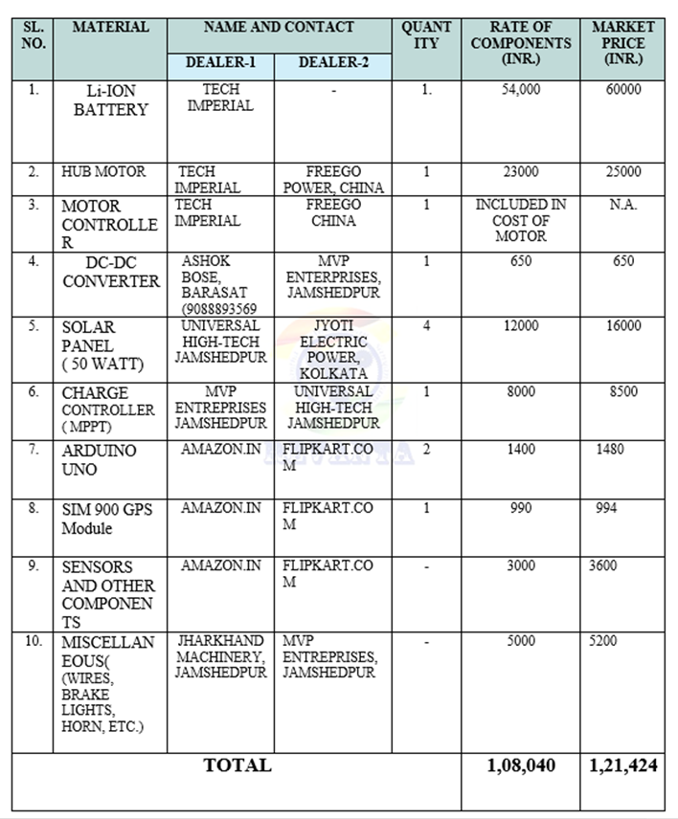
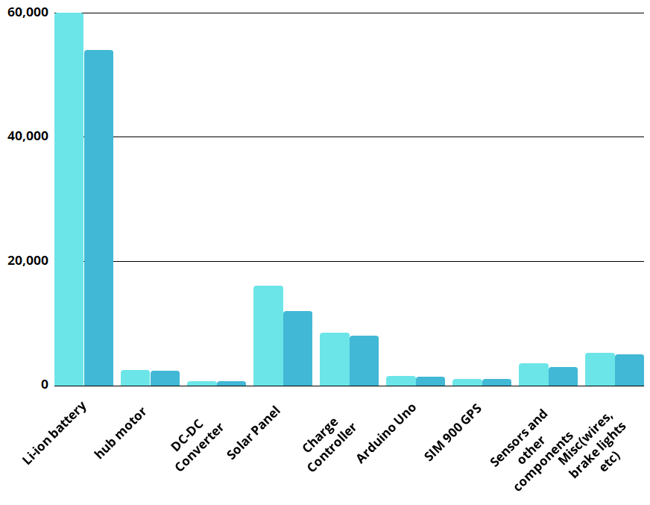


4. ELECTRICAL AND ELECTRONICS

Slide 7
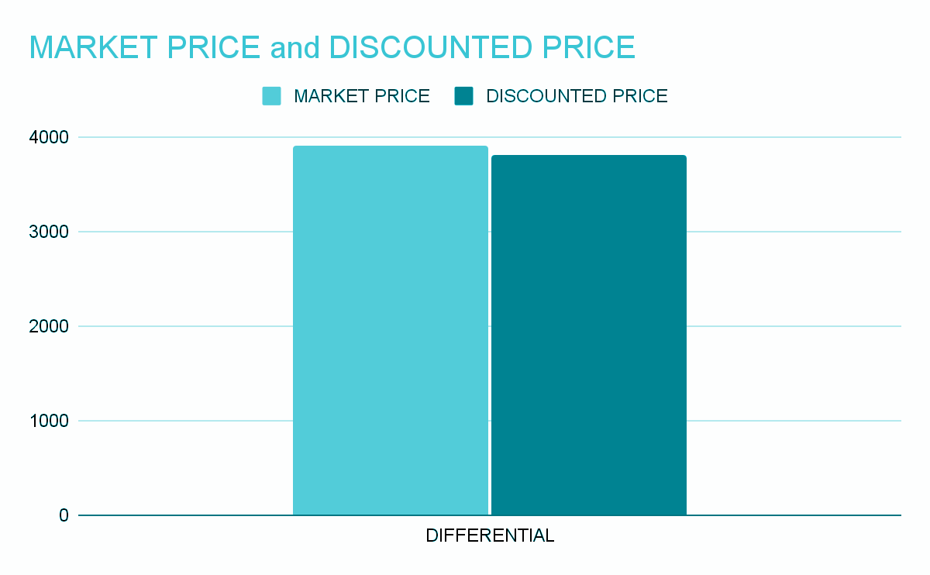

5.TRANSMISSION SYSTEM
SI. NO | MATERIAL | NAME AND CONTACT | QUANTITY | RATE OF COMPONENTS (INR) | MARKET PRICE(INR)
1. | Differential | Nanya airconn Pvt ltd | 1 | 3800 | 3900
TOTAL |  |  |  | 3800 | 3900
COST REDUCED=RS. 100

Slide 8
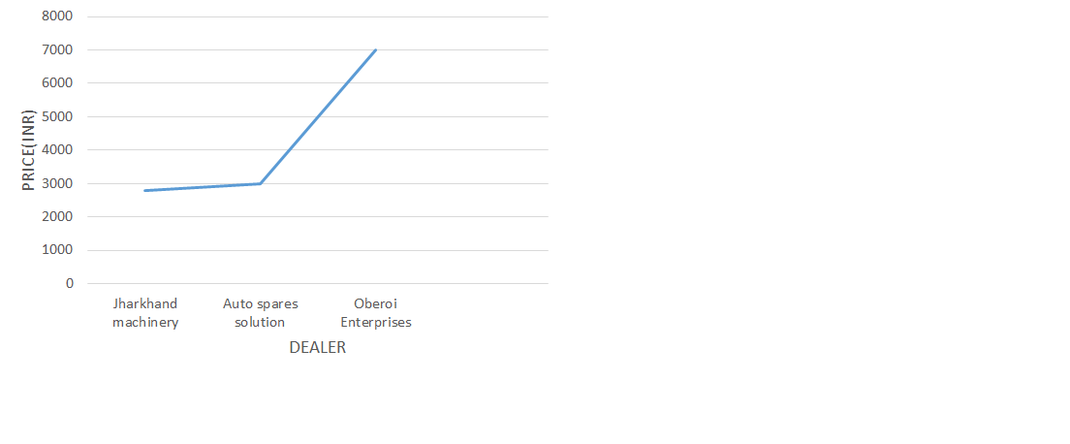
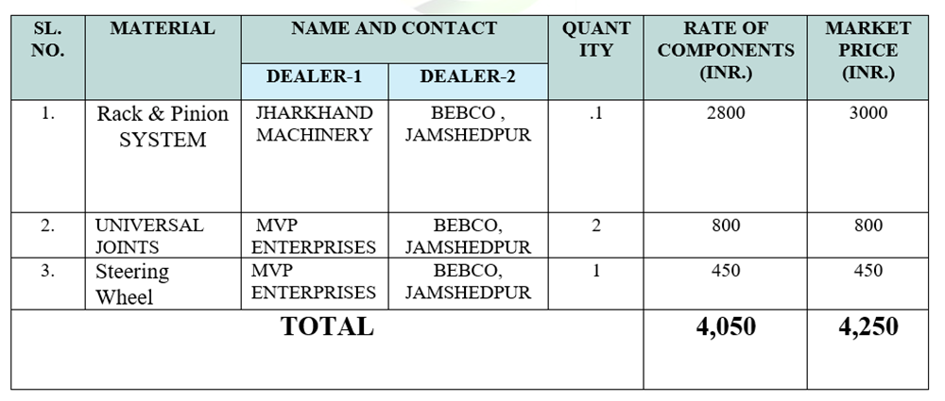
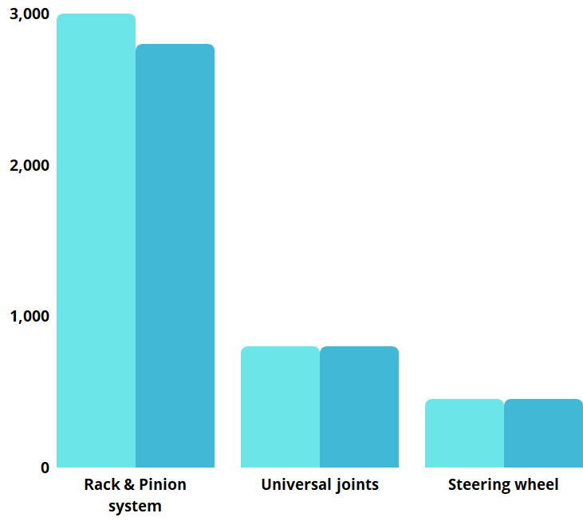
6. STEERING SYSTEM
Rack and Pinion system
COST REDUCED = Rs 200

Slide 9
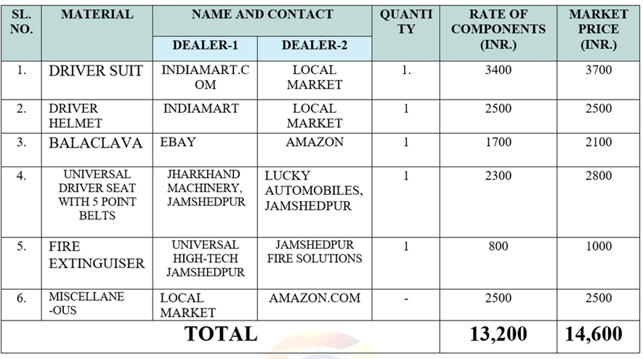
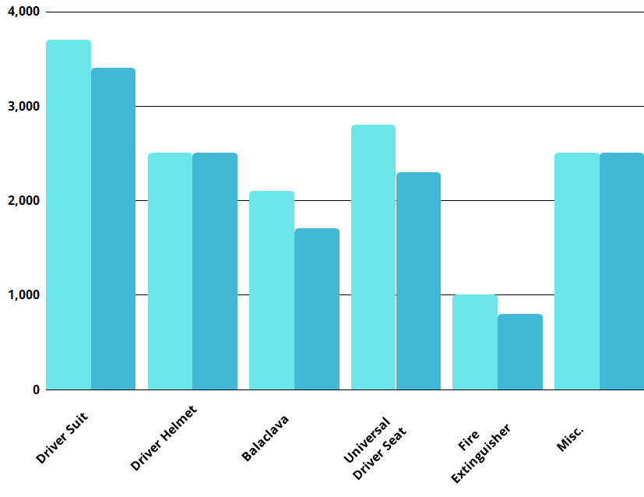

7. SAFETY AND ERGONOMICS

Slide 10
8. INNOVATION
S NO. | MATERIAL | PRICE/UNIT | QUANTITY | TOTAL
1 | ARDUINO UNO | 500 | 4 | 2000
2 | ARDUINO MEGA | 1200 | 1 | 1200
3 | 2*16 LCD | 200 | 2 | 400
4 | FINGERPRINT SENSOR | 800 | 1 | 800
5 | RELAY MODULE | 50 | 4 | 200
6 | ULTRASONIC SENSOR | 100 | 2 | 200
7 | BUZZER | 60 | 2 | 120
8 | LDR | 10 | 8 | 80
9 | LINEAR ACTUATOR | 3000 | 2 | 6000
10 | BLUETOOTH MODULE | 250 | 1 | 250
11 | SMOKE SENSOR | 100 | 3 | 300
12 | GPS MODULE | 700 | 1 | 700
13 | SERVO MOTOR | 6000 | 1 | 6000
TOTAL
12970
32
18250

Slide 11
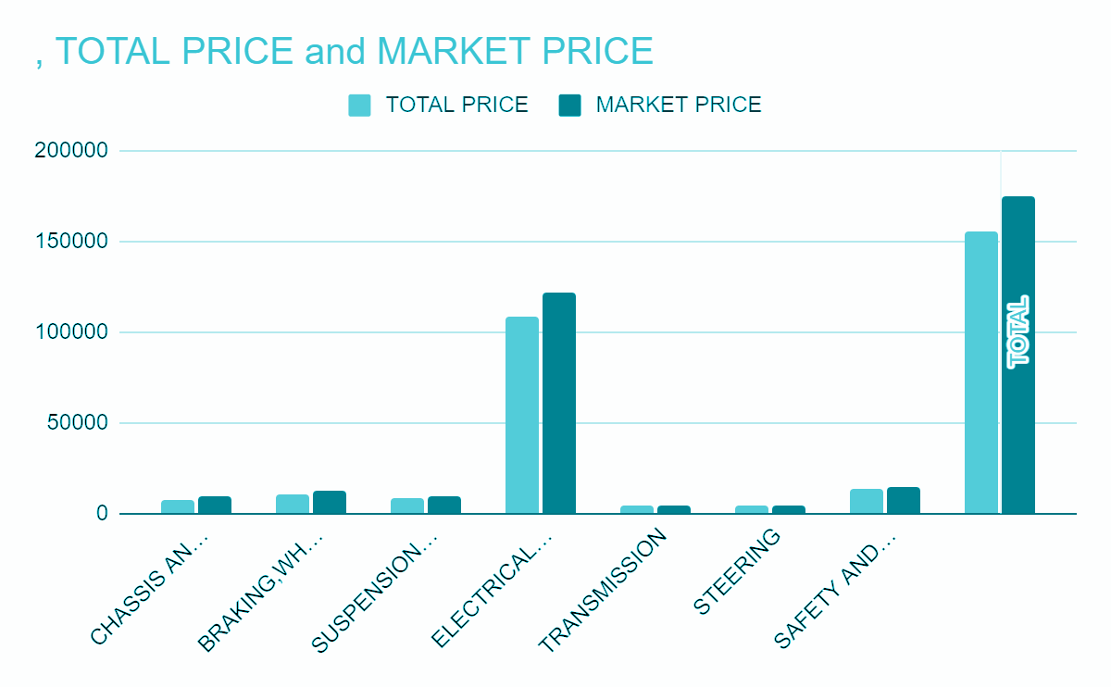
Conclusion
 | TOTAL PRICE | MARKET PRICE
CHASSIS AND BODY WORKS | 7700 | 9000
BRAKING,WHEELS AND TYRES | 10600 | 11950
SUSPENSION SYSTEM | 8050 | 9500
ELECTRICAL AND ELECTRONICS | 108040 | 121424
TRANSMISSION | 3800 | 3900
STEERING | 4050 | 4250
SAFETY AND ERGONOMICS | 13200 | 14600
INNOVATION | 18250
TOTAL | 173690 | 174624
TOTAL COST REDUCED = Rs 19,184

